Slide 1


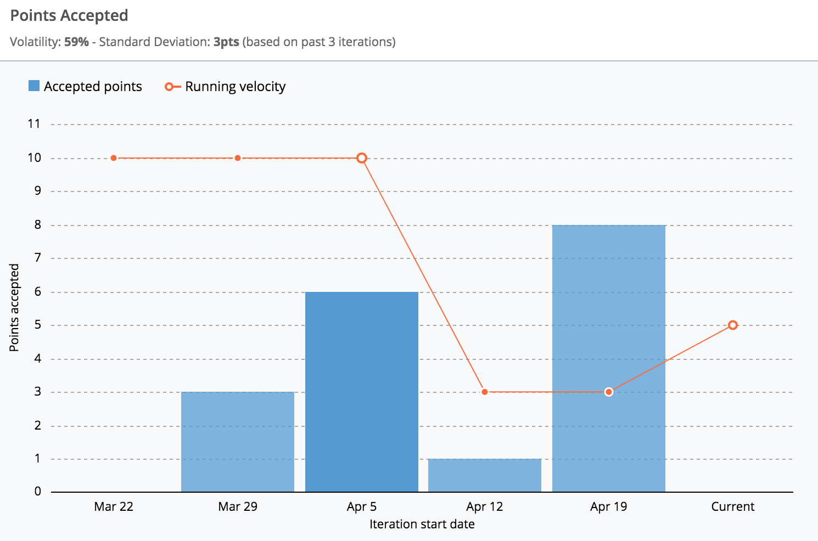
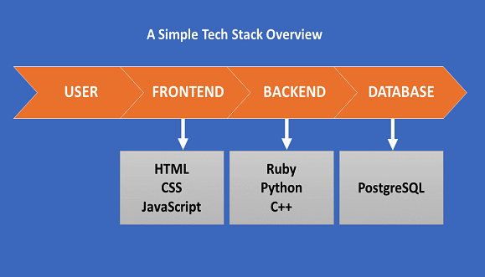
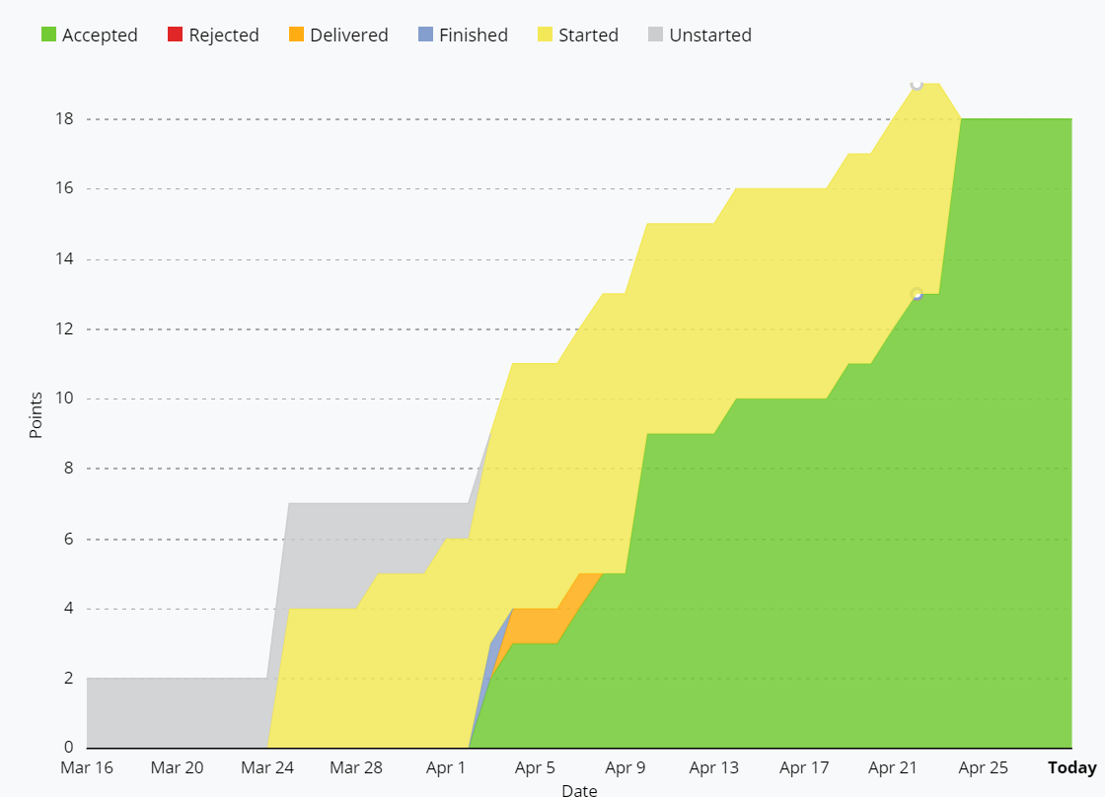
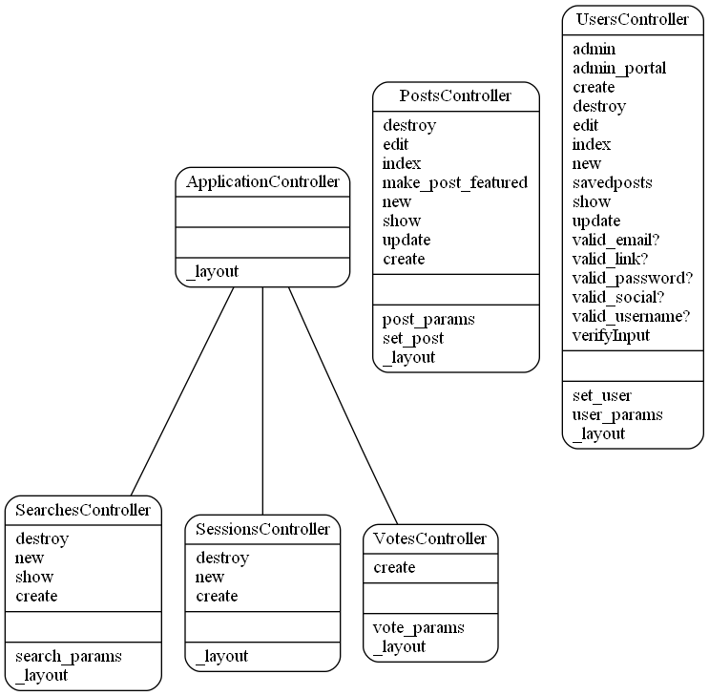
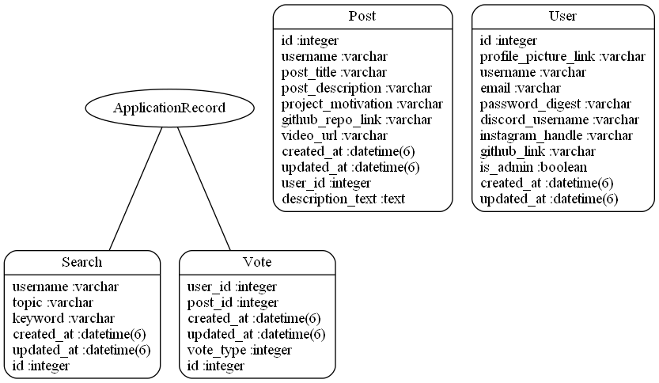
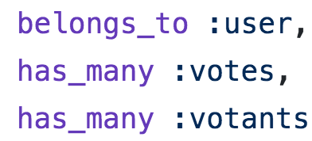
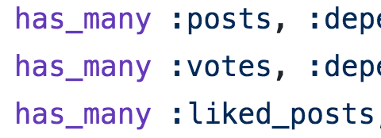

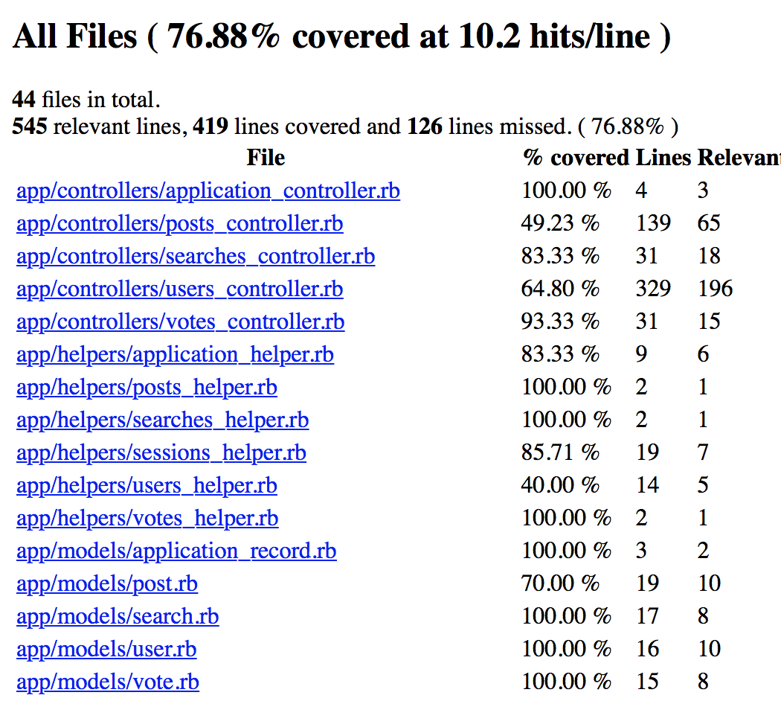
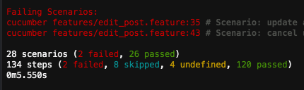
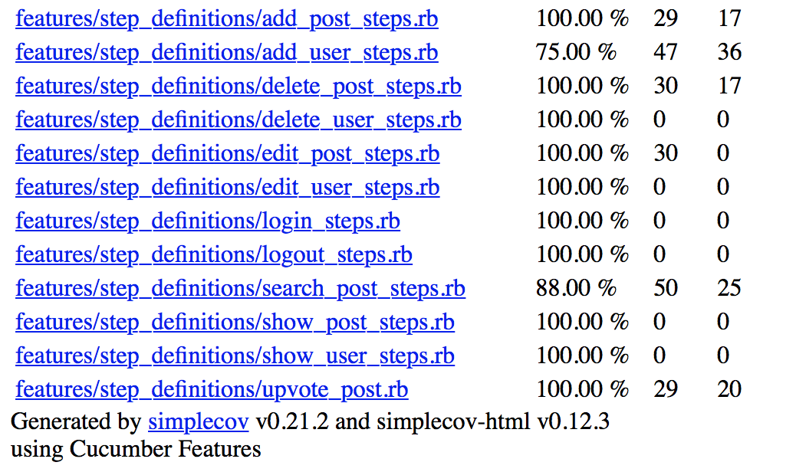
DevHub
Project Owner: Colby Mainard Scrum Master: Jingdi Zhang
Team Member: Fatma Elsheimy, Peiwen Wang, Hayoung Jeon, Raghu Veerappa
Dept. of Computer Science and Engineering, Texas A&M University
Introduction
User Stories
DevHub is a web application that would allow developers of all levels to showcase completed projects, reach out for community support, and ask for feedback from the community.
This web application facilitates these goals in several ways. First, by allowing anyone to create an account and post, this would allow users with a valid email address to create an account and include various socials to connect with the programming community.
Second, by allowing users to create posts centered around their projects, it would allow users to display the current status of their project, do a quick demo, and seek help from other developers. Hence, the website acts like a small community that brings like-minded people together.
Several user stories were implemented throughout the semester. The most significant ones are listed below:
Login and Authentication (1’)
Create and edit user profile (2’)
Create and edit post (2’)
Upvote post (1’)
Search by topic/user/keywords (2’)
Markup support for posts (1’)
Promote to moderator and Delete user (2’)
Total points of user stories implemented: 18 ’
Tech Stack
Cumulative Flow Graph
HTML
CSS
JavaScript
Ruby on
Rails
SQLite3
Deploy our Rails app on Heroku, change the database from sqlite to PostgrSQL
UML Diagram
Controller
Model
Post
User
Vote
Testing Results
Challenges
Ran out of time to finish all the requested features
Routing issues;
Deploy issue: database change; strange merge conflicts
BDD => cucumber
Coverage => SimpleCov
Feedback from Customer
Was overall happy with the end results
Did not get all requested features
CSS / Views may require small changes to meet all themes
TDD => Rspec
Reference
GitHub Repo Link: https://github.com/ColbyMainard/DevHub
Heroku Link: https://agile-springs-16363.herokuapp.com/

